Slide 1
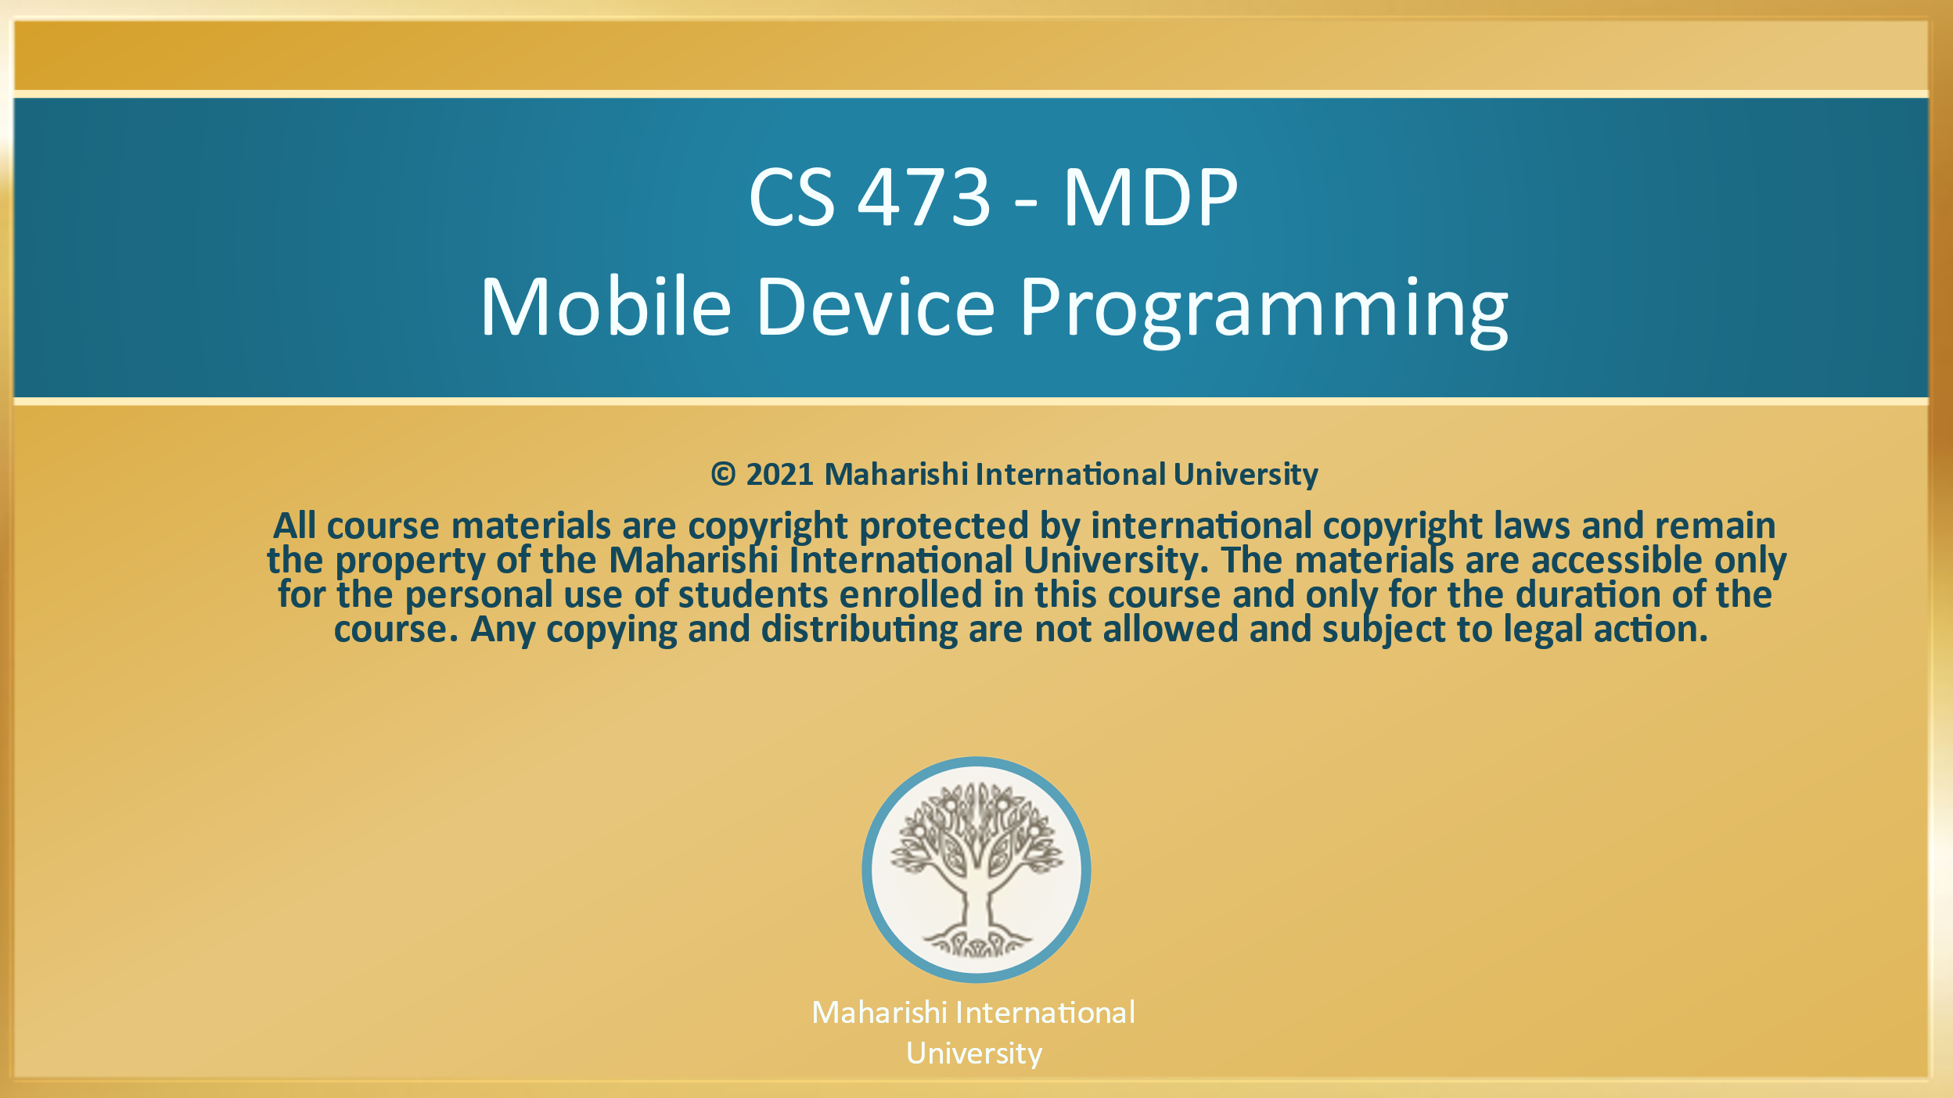

Slide 2
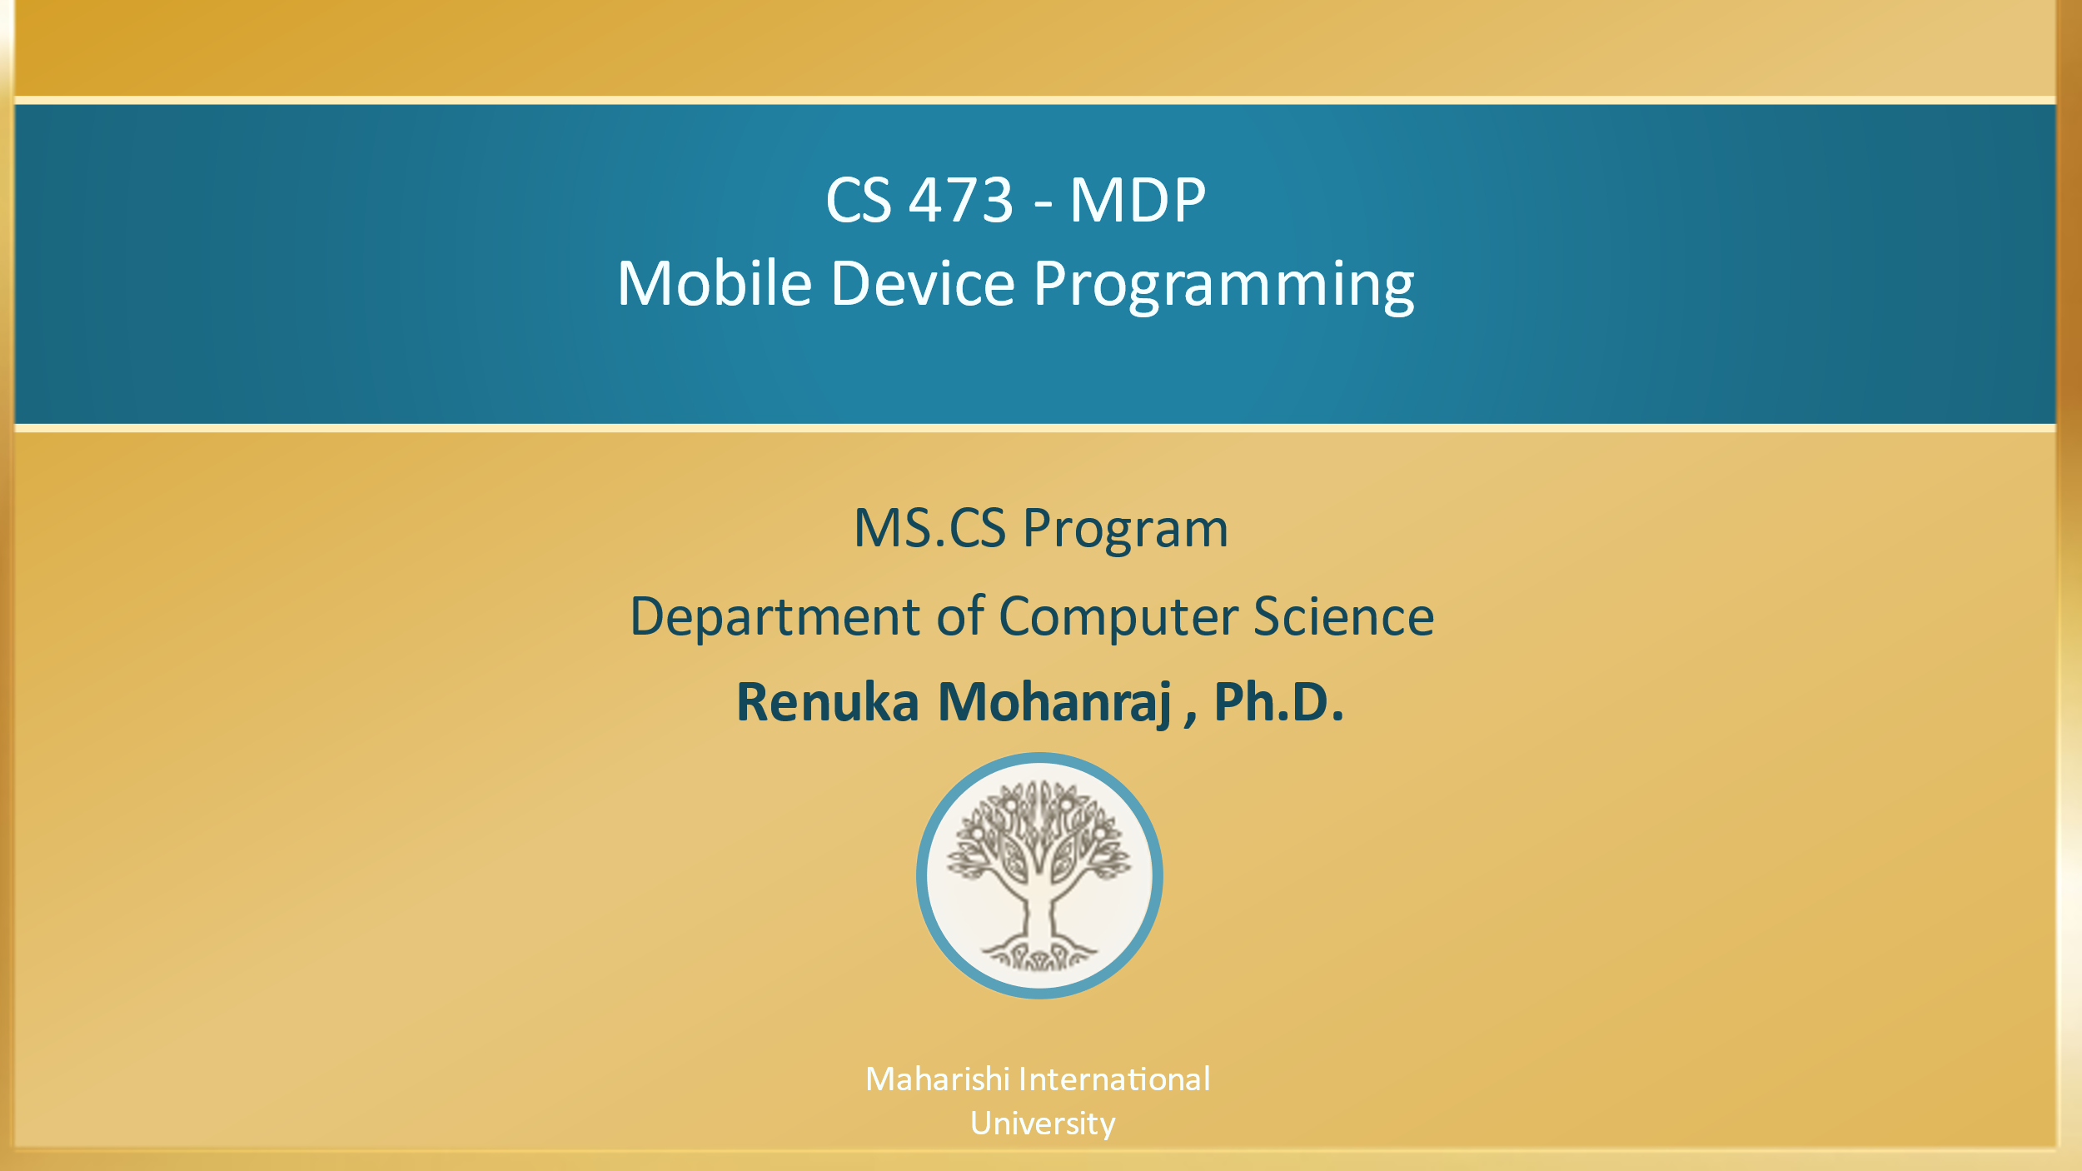

Slide 3

CS 473 – MDP
Mobile Device Programming
Lesson-6 User Input Controls – Day 2
Advanced UI – RecyclerView and CardView
Maharishi International
University

Slide 4
Contents
What is a Recycler View?
RecyclerView Components Overview
Implementing RecyclerView Steps
Hands on Example – 1 using RecyclerView to show the Book List
CardView
Hands on Example – 2 using RecyclerView, CardView and Listener Implementation

Slide 5
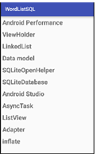
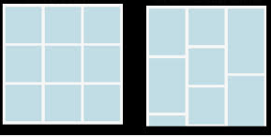
What is a Recycler View?
Scrollable container for large data sets
Efficient
uses and reuses limited number of views
Updates changing data fast
RecyclerView also provides a choice of three built-in layout managers to control the way in which the list items are presented to the user
LinearLayoutManager
GridLayoutManager
StaggeredGridLayoutManager

Slide 6
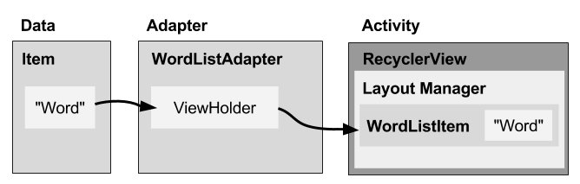
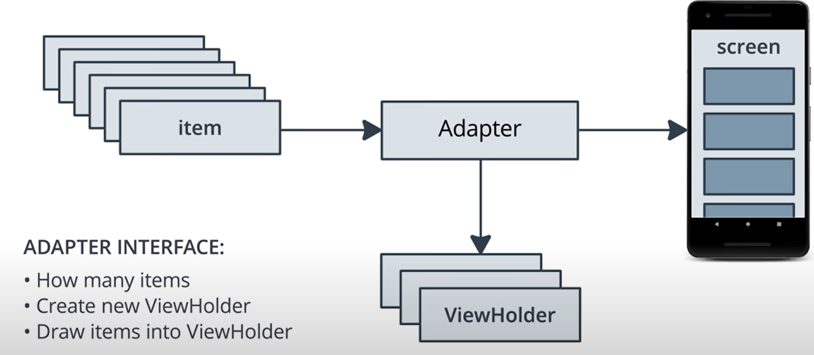
RecyclerView Components Overview
Data
RecyclerView scrolling list —RecyclerView
Layout for one item of data—XML file
Layout manager handles the organization of UI components in a view—Recyclerview.LayoutManager
Adapter connects data to the RecyclerView—RecyclerView.Adapter
View holder has view information for displaying one item—RecyclerView.ViewHolder

Slide 7
Implementing RecyclerView Steps
Add the RecyclerView just drag the RecyclerCiew in the Layout
Create XML layout for item
Extend RecyclerView.Adapter
Extend RecyclerView.ViewHolder
In onCreate of activity, create a RecyclerView with adapter and layout manager
Refer step by step implementation and Demo codes from Lesson6 Day2

Slide 8
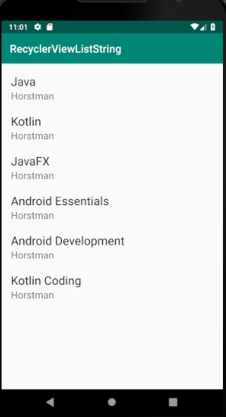
Hands on Example - 1
Problem :
Show the RecyclerView with the list of Books.
Book is data class with the attributes book name and author.
Refer : Lesson6/
BookRecyclerViewList

Slide 9
Adding RecyclerView in the layout
Step:1 In your activity_main.xml layout add the RecyclerView as below
Add RecyclerView to XML Layout
<androidx.recyclerview.widget.RecyclerView
android:id="@+id/recyclerview"
android:layout_width="match_parent"
android:layout_height="match_parent"/>

Slide 10
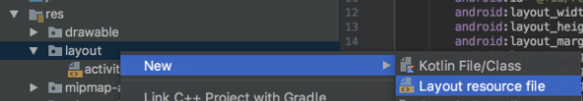
Creating new layout to display the list item
Step 2. Create layout to show the Book item as per the screenshot and give a name as item_layout.xml

Slide 11
item_layout.xml
<LinearLayout xmlns:android="http://schemas.android.com
/apk/res/android"
android:orientation="vertical"
android:layout_width="match_parent"
android:layout_height="wrap_content"
android:padding="10dp">
<TextView
android:textAppearance="@style/
Base.TextAppearance.AppCompat.Large"
android:id="@+id/name"
android:text="Book Name"
android:layout_width="match_parent"
android:layout_height="wrap_content" />

Slide 12
item_layout.xml
<TextView
android:textAppearance="@style/
Base.TextAppearance.AppCompat.Medium"
android:text="Author"
android:id="@+id/author"
android:layout_width="match_parent"
android:layout_height="wrap_content"/>
</LinearLayout>

Slide 13
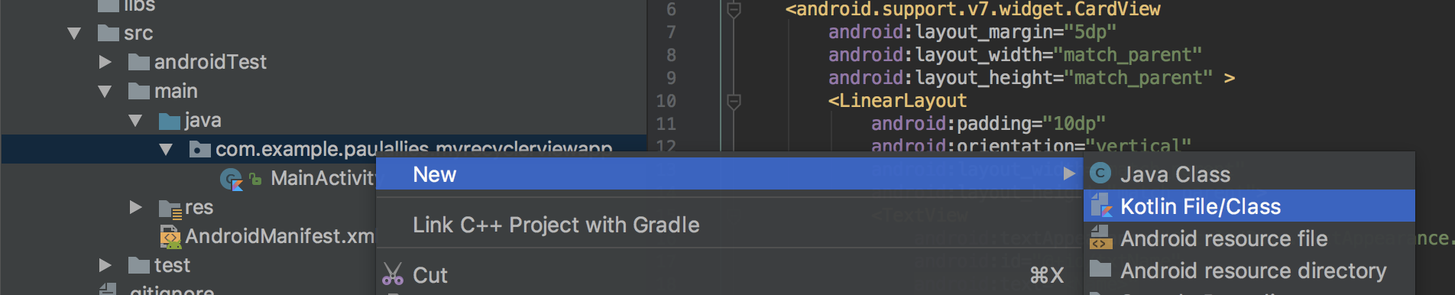
Create a Data Class for Book
Create Book.kt file as per the screenshot.
Book.kt file code
data class Book(val name: String, val author: String)

Slide 14
Implementing RecyclerView
Implement the adapter by creating MyAdapter.kt
Adapter has 3 required methods need to implement
onCreateViewHolder()
This method creates and returns a ViewHolder object initialized with the view that is to be used to display the data. This view is typically created by inflating the XML layout file.
onBindViewHolder()
This method is passed the ViewHolder object created by the onCreateViewHolder() method together with an integer value indicating the list item that is about to be displayed. Contained within the ViewHolder object is the layout assigned by the onCreateViewHolder() method. It is the responsibility of the onBindViewHolder() method to populate the views in the layout with the text and graphics corresponding to the specified item and to return the object to the RecyclerView where it will be presented to the user.
getItemCount()
This method must return a count of the number of items that are to be displayed in the list.

Slide 15
Step 3: Implement the adapter in MyAdapter.kt
class MyAdapter(var blist: ArrayList<Book>) : RecyclerView.Adapter<MyAdapter.MyViewHolder>() {
override fun onCreateViewHolder(parent: ViewGroup, viewType: Int): MyAdapter.MyViewHolder {
val view =
LayoutInflater.from(parent.context).inflate(R.layout.item_list,parent,false)
return MyViewHolder(view)
}
override fun onBindViewHolder(holder: MyAdapter.MyViewHolder, position: Int) {
holder.itemView.name.text = blist[position].name
holder.itemView.author.text = blist[position].author
}
// return Size of the list of data.
override fun getItemCount(): Int {
return blist.size
}
inner class MyViewHolder(itemView: View) : RecyclerView.ViewHolder(itemView)
}

Slide 16
Step4: Implementing RecyclerView in MainActivity.kt
class MainActivity : AppCompatActivity() {
override fun onCreate(savedInstanceState: Bundle?) {
super.onCreate(savedInstanceState)
setContentView(R.layout.activity_main)
val books = ArrayList<Book>()
books.add(Book("Java","Horstman"))
books.add(Book("Kotlin","Joshua Bloch"))
books.add(Book("JavaFX","Herbert"))
books.add(Book("Android Essentials","Kathy"))
books.add(Book("Android Development","Bruce"))
// Set the Layout Manager
recyclerView1.layoutManager =LinearLayoutManager(this)
// Create an object for the MyAdapter
val adapter = MyAdapter(books)
// Set adapter to your RecyclerView
recyclerView1.adapter = adapter
}
}

Slide 17
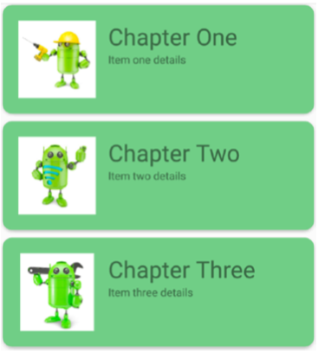
CardView
Android 7.0 introduces a new widget called CardView.
CardView wraps a layout and will often be the container used in a layout for each item within a ListView or RecyclerView.
Appeared with shadow effects and rounded corners.
CardView API is an easy way for you to show information inside cards that have a consistent look across the platform.

Slide 18
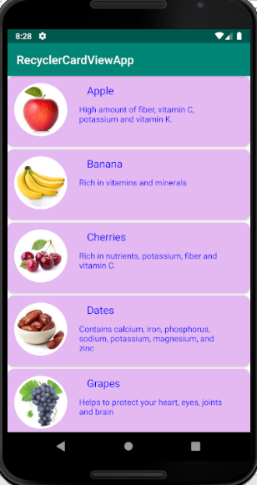
Hands on Example - 2
This example uses
Recyclerview displays the Fruit list
Each item displayed using CardView. Each row displayed with Fruit image, name of the fruit and small description about the fruit.
To display the image in circle shape needs third party library xml code as mentioned below.
<com.mikhaellopez.circularimageview.CircularImageView
android:id="@+id/imageView"
android:layout_width="90dp"
android:layout_height="90dp"
android:src="@mipmap/ic_launcher" />
Include the below line in build.gradle dependencies
implementation 'de.hdodenhof:circleimageview:3.0.1’
Refer without third party library to show the image in different shapes Demo: CircularViewCustom

Slide 19
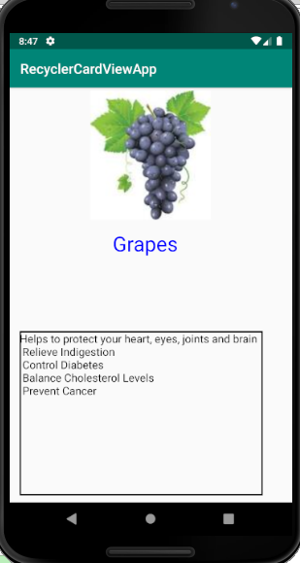
Hands on Example - 2
Once clicking each item, opens another activity gives detail description about the fruit. Here is the screen after clicking Grapes.
Refer : Lesson6\FruitCardView

Slide 20
Adding CardView Layout
XML Code for the CardView
<androidx.cardview.widget.CardView
xmlns:android="http://schemas.android.com/apk/res/android"
xmlns:app="http://schemas.android.com/apk/res-auto"
android:layout_width="match_parent"
android:layout_height="wrap_content"
android:padding="20dp"
android:id="@+id/card_view"
app:cardBackgroundColor="#e4b9f1"
app:cardCornerRadius="12dp"
android:layout_marginBottom="4dp">

Slide 21
ListView vs RecyclerView
ListView
ListView provides only one type of view i.e Vertical ListView, and there is no way to implement the others such as Horizontal ListView, GridView etc.
RecyclerView :
RecyclerView, with faster performance, is the advanced version of ListView which can be used to implement Vertical List, Horizontal List and Gridview with the help of Layout Managers.
RecyclerView is a container for displaying large data sets that can be scrolled very efficiently by maintaining a limited number of views.

Slide 22
Main Point 4
RecyclerView is flexible and efficient version of ListView. It is a container for rendering larger data set of views that can be recycled and scrolled very efficiently. RecyclerView is like traditional ListView widget, but with more flexibility to customizes and optimized to work with larger datasets.
Science of Consciousness: pure awareness is an abstraction of individual awareness; each individual provides a specific, concrete realization of unbounded and unmoving pure awareness. Pure awareness is more efficient and powerful.

Slide 23
